Slide 1

Reactive programming
Spring WEBFLUX
PRESENTED BY:
Bogdan - Adrian Enache
java_programmer@edenred_digital_center
Thinker, Talker, Father
This work belongs to me but the information here not.

Slide 2
Reactive programming
1. What is reactive programming?
2. Dive in – Spring Webflux flavor
3. Live coding session

Slide 3
What is reactive
programming?

Slide 4
Definition
There are plenty of bad explanations and definitions out there on the internet. In mart most of them express only a part of the hole picture.
Mostly, as a java developer I agree with one: Reactive programming is programming with asynchronous data streams.

Slide 5
But what exactly
that even means?

Slide 6
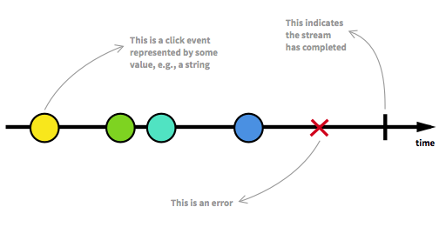
Events that keep coming… or not..
Anything can be a stream: variables, user inputs, properties, caches, data structures, etc. A stream is a sequence of ongoing events ordered in time. It can emit three different things: a value (of some type), an error, or a "completed" signal.

Slide 7
To better understand restrictiveness lets overview the reactive manifesto
Responsive — Fast feedback loop for the user to make him/her feel in power
Elastic — The application stays responsive no matter the workload. It can scale up.
Resilient — It deals with problems along the way and stays responsive in the face of failure.
Message Driven — changes are propagated through messages.

Slide 8
“Old” versus “new” paradigm
Do you know how a restaurant works?

Slide 9
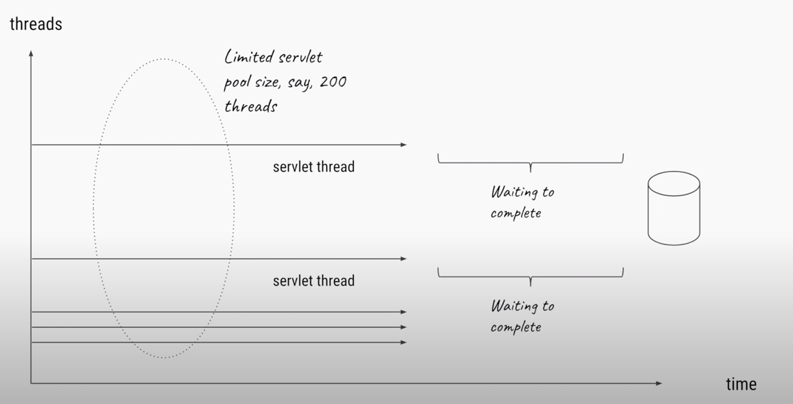
Example 1 – old style

Slide 10
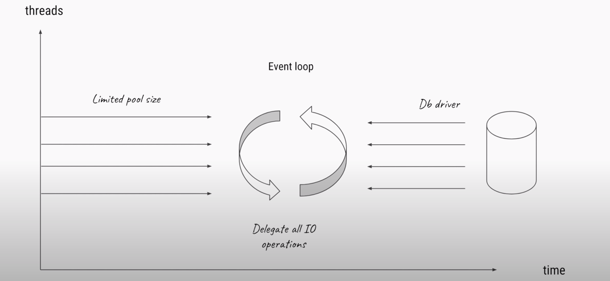
Example 2 – new style

Slide 11
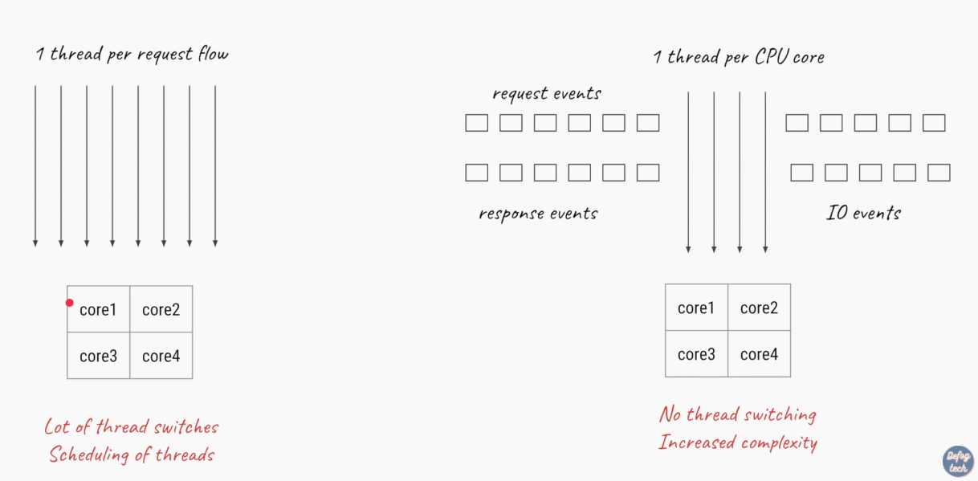
Side by Side

Slide 12
So how does it work?
In the world of reacting programming the pipeline implements the Producer-Consumer Dataflow pattern. For the pipeline to become reactive we add the observer pattern, asynchronous calls with message callback and lazy evaluation. In reactive programming, the producer is an observable and the consumer is an observer.

Slide 13
What does it need to go full reactive?
In order to go full reactive the code is only the first part. As depicted above but not really mentioned there is a database involved. There is always a database involved.
Oh well almost! So, in order to go full reactive we need a database to support it and a compliant driver for it.

Slide 14
Spring Webflux

Slide 15
What is it?
Spring webflux is an implementation of Reactive manifesto.
Built on top of Project reactor.
Usage should be familiar to Spring users, at least to some degree

Slide 16
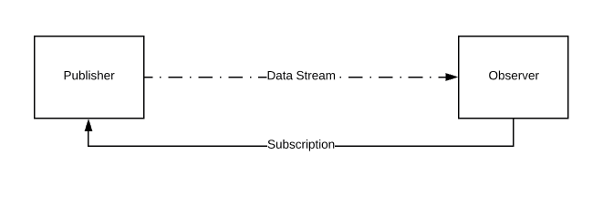
What is under the hood?
Make acquaintance with the Reactive implementation of Observer pattern:
Publisher / Observable
Observer / Subscriber
Subscription
Processor / Operators

Slide 17
Publisher
Publisher is observable whom we are interested in listening to! These are the data sources or streams

Slide 18
Observer
Observer subscribes to Observable/Publisher. Observer reacts to the data emitted by the Publisher. Publisher pushes the data to the Observers. Publishers are read-only whereas Observers are write-only.

Slide 19
Subscription
Observer subscribes to Observable/Publisher via an object called Subscription. Publisher’s emitting rate might be higher than Observer’s processing rate. So in that case, Observer might send some feedback to the Publisher – that has been named
“backpresure”

Slide 20
Processor/ Operators
Processor acts as both Publisher and Observer. They stay in between a Publisher and an Observer. It consumes the messages from a publisher, manipulates it and sends the processed message to its subscribers. They can be used to chain multiple processors in between a Publisher or an Observer.

Slide 21
Salt & Pepper of reactive

Slide 22
Publishers in Webflux
Mono → publishes a single entity - at most one or an error
Flux → publishes multiple entities - at least one or an error
All of these things are, ultimately, just implementations of Publisher<T> for different needs. They produce data that a Subscriber eventually consumes. Whenever you have a Publisher<T>, there’s bound to be a Subscriber<T> somewhere.

Slide 23
Operators
Sounds abstract ?? It really should not. Despite some differences operators look pretty much alike methods applied to good old java 8 stream
There are tons of operators. We’ll review them shortly, but what you need to remember is that they don’t affect the publisher on which they operate. They create new Publishers. Each Publisher<T> is immutable.

Slide 24
Operators Examples

Slide 25
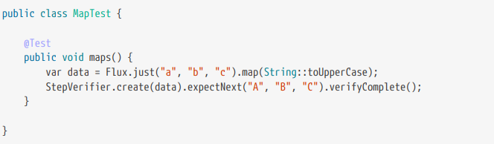
Map
Applies a function to each item emitted in the stream. This function modifies each item by the source Publisher<T> and emits the modified item. The source stream gets replaced with another stream whose values are the output of the function applied to each item in the source stream.

Slide 26
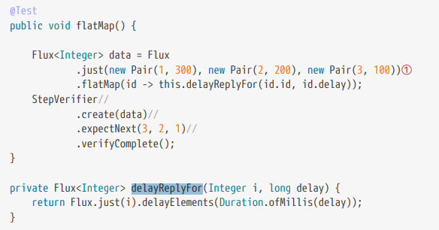
FlatMap
Works similar with those applied to stream to avoid Optional<Optional<T>> only that this time saves us from the nasty Publisher<Publisher<T>>

Slide 27
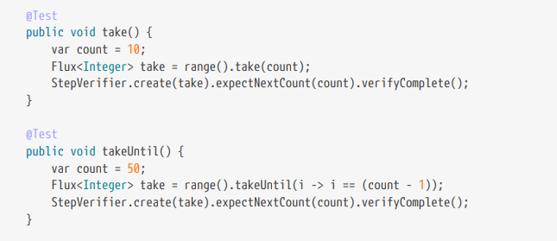
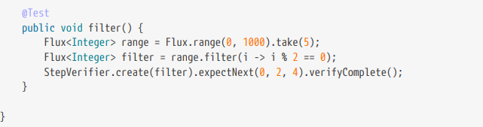
Take and Filter
A Publisher<T> might emit an infinite number of records, and you may not be interested in everything.

Slide 28
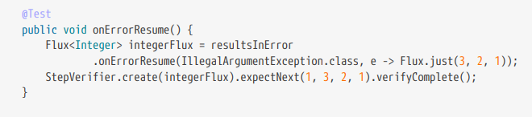
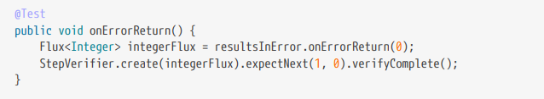
Errors? Just another type of data
If a reactive stream results in an error, then you can trap that error and decide what happens using various operators whose name usually starts with on\*

Slide 29
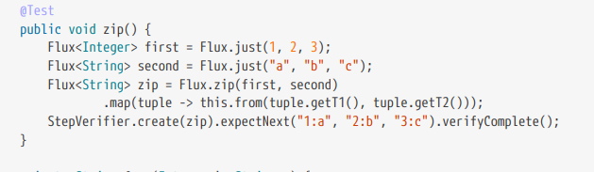
Zip
Glues multiple publishers together and returns a tuple

Slide 30
Thanks for watching!
Now lets dive into some code and then hopefully not into some questions
CONTACT:
bogdan19adrian@gmail.com
As I said at the start, presentation belongs to me but the stuff in here not I hope you have learned something today as I did in the days I prepared it

